Slide 1


DATA NORMALIZATION
IN SQL

Slide 2
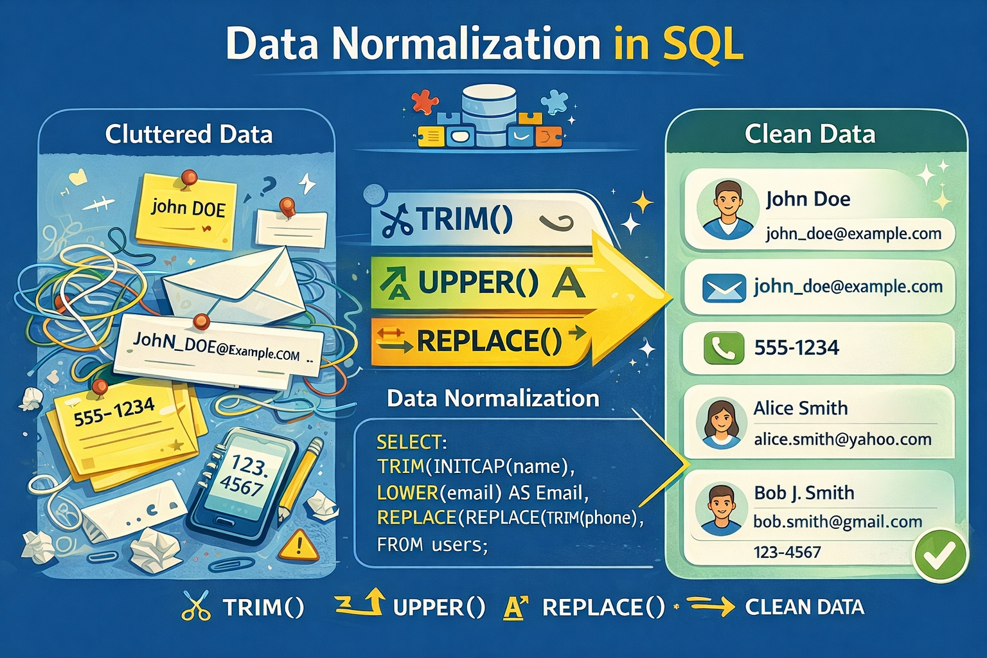
What is Data Normalization?
Data Normalization is the process of cleaning and standardizing raw data for consistent storage and analysis.
In SQL, normalization ensures:
Removal of duplicates
Consistent text casing
Proper data types
Clean and analyzable datasets

Slide 3
Why Normalize Data?
Raw data often comes with:
Leading/trailing spaces
Mixed casing (upper/lower)
Duplicate records
Different formats (phone numbers, emails, IDs)
Wrong data types (VARCHAR instead of INT/DECIMAL)
Benefits of normalization:
Accurate analytics and reporting
Correct grouping and aggregation

Slide 4


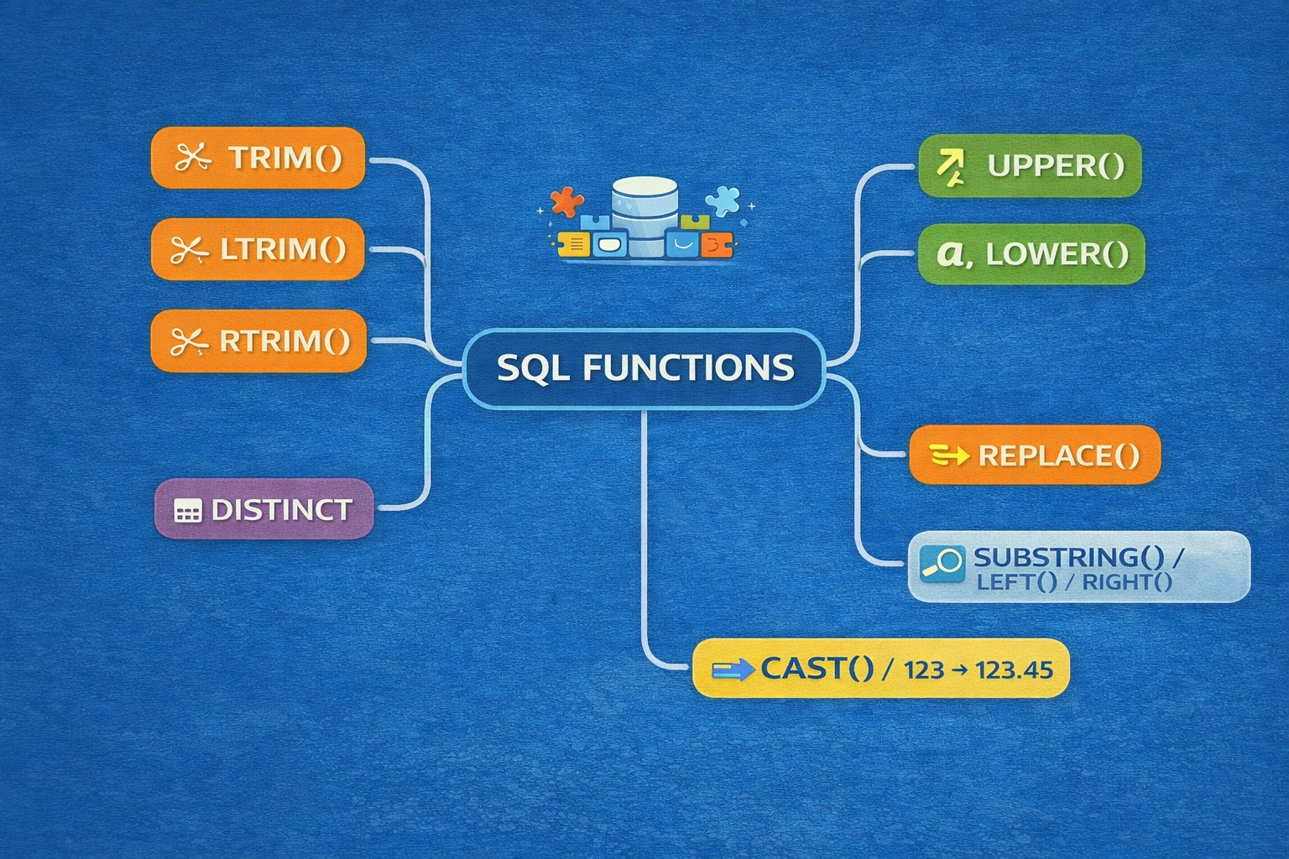

Slide 5

Data Normalization Functions
1 TRIM() - Removes leading and trailing spaces from a string
Prevents invisible duplicates in text fields like names, city, or codes.
Helps DISTINCT, GROUP BY, and joins work correctly.
Note - TRIM does not remove spaces in between words.
2 LTRIM() - Left Trim
Removes spaces only from the left (beginning) of a string.
Can help with standardizing inputs before comparison.
3 RTRIM() - Right Trim
Removes spaces only from the right (end) of a string.
Common when CHAR columns automatically pad values with trailing spaces.

Slide 6
Data Normalization Functions
4 UPPER()- Converts all text in a string to uppercase.
Standardizes categorical fields like course, city, or status.
Ensures DISTINCT and GROUP BY do not treat the same value with different casing as separate.
5 LOWER()- Converts all text in a string to lowercase.
Ideal for emails, usernames, or IDs where casing is inconsistent.
Prevents duplicates in authentication or analytics.
6 DISTINCT- Returns unique rows from a query result.
Remove duplicate logical values after cleaning with TRIM and UPPER/LOWER.
DISTINCT does not clean data — it only removes duplicates in the result set.

Slide 7


Data Normalization Functions
8 REPLACE()- Replaces all occurrences of a substring within a string with another string
Standardizes data formats:
Phone numbers ((987)654-3210 → 9876543210)
IDs, codes, and postal codes
Removes unwanted characters like -, (, ) or spaces.
9 SUBSTRING() / LEFT() / RIGHT()-Extracts portions of a string.
SUBSTRING(str, start, length) → part of the string starting at start.
LEFT(str, n) → first n characters.
RIGHT(str, n) → last n characters.
10 CAST() / CONVERT()-Converts data from one type to another (string ↔ numeric, string ↔ date, etc.).
Convert numeric data stored as VARCHAR to INT/DECIMAL for aggregation.
Convert date strings to DATE type for calculations.

Slide 8
What is a Stored Procedure?
A stored procedure is a precompiled set of SQL statements stored in the database that can be executed repeatedly.
Key Points:
Stored procedures are saved in the database.
Can accept input parameters and return output results.
Reduces repetition of code and improves performance.
Encapsulates logic in one reusable object.
Example:
Think of a stored procedure as a “function” in programming. You call it whenever needed without rewriting the code.

Slide 9
Why Use Stored Procedures?
Benefits:
Reusability: Write once, call multiple times.
Performance: Precompiled → faster execution.
Security: Can grant users access to SP without giving access to underlying tables.
Maintainability: Logic centralized → easier updates.
Reduced Network Traffic: Multiple SQL statements can be executed with a single call.

Slide 10
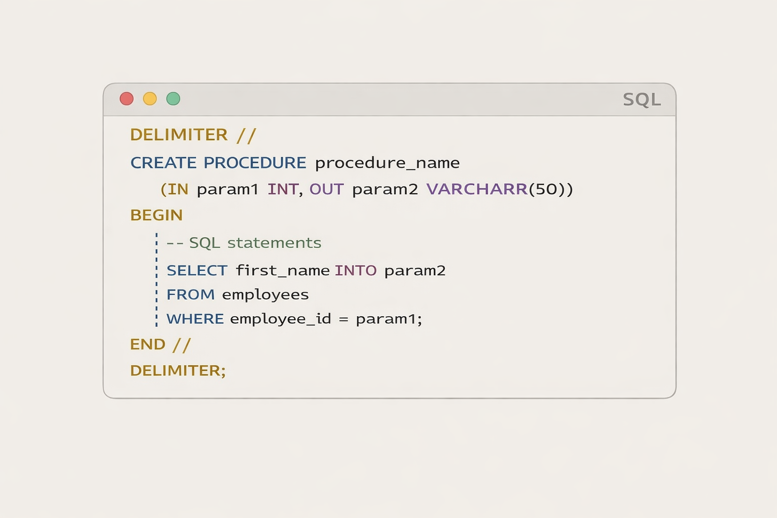
Syntax of a Stored Procedure
Explanation:
DELIMITER // → tells MySQL that statements inside SP end with // instead of ;
IN param1 → input parameter
OUT param2 → output parameter
BEGIN ... END → block of SQL statements
Why DELIMITER is needed:
By default, MySQL treats ; as end of a statement.
In a stored procedure, you often have multiple SQL statements.
Changing delimiter allows MySQL to recognize the start and end of the procedure correctly.

Slide 11
Use Cases for Stored Procedures
Data Transformation / ETL
Example: Normalize data from multiple source tables into a clean table.
Batch Operations
Insert, update, or delete multiple rows based on conditions.
Encapsulate Business Logic
Example: Calculate employee bonuses, validate entries.
Reporting
Aggregate data for dashboards or analytics.
Repetitive Tasks
Any SQL you call frequently or on a schedule.

